Slide 1
Heap Data Structure

Slide 2
Heaps
A (binary) heap data structure is an array object that can be viewed as a complete binary tree
Each node of the tree corresponds to an element of the array that stores the value in the node
A complete binary tree is one where all the internal nodes have
exactly 2 children, and all the leaves are on the same level. The tree is completely filled on all levels except possibly the lowest, which is filled from left to right up to a point
Leaf nodes are nodes without children.
← Interior node
← Leaf node
^{Edge} →

Slide 3
Heaps
Height of a node: The number of edges starting at that node, and going down to the furthest leaf.
Height of the heap: The maximum number of edges from the root to a leaf.
← ^{Root}
Height of root = 3
Height of blue node = 1

Slide 4
Heaps
Complete binary tree– if not full, then the only unfilled level is filled in from left to right.
1 1
2 2
3
3
4
⁵ 6 7 ⁴
9 10 11 12 13 ⁷
5
6
8
8 9
10 11
12
Parent(i)=
return ⎣i/2⎦
Left(i)=
return 2i
Right(i)=
return 2i + 1

Slide 5
Heaps
The heap property of a tree is a condition that must be true for the tree to be considered a heap.
Min-heap property: for min-heaps, requires A[parent(i)] ≤ A[i]
So, the root of any sub-tree holds the least value in that sub-tree.
Max-heap property: for max-heaps, requires A[parent(i)] ≥ A[i]
The root of any sub-tree holds the greatest value in the sub-tree.

Slide 6
Heaps
Looks like a max heap, but max-heap property is violated at indices 11 and 12. Why?
because those nodes’ parents have smaller values than their children.
1
9
2
3
8
8
4
8
5
7
6
8
7
1
8
6
9
7
10
5
11
8
12
9

Slide 7
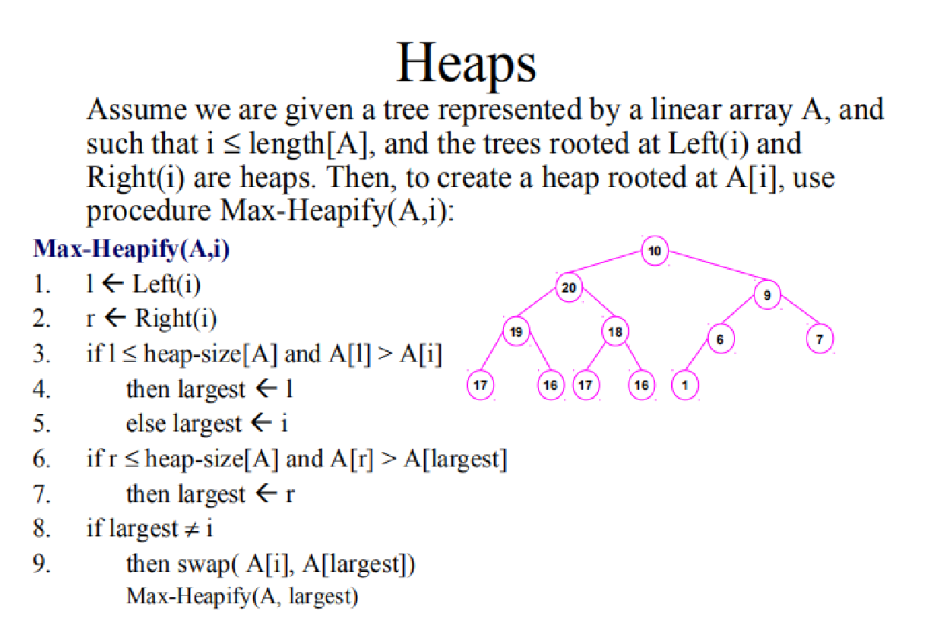

Slide 8
Heaps
If either child of A[i] is greater than A[i], the greatest child is exchanged with A[i]. So, A[i] moves down in the heap.
The move of A[i] may have caused a violation of the max- heap property at it’s new location.
So, we must recursively call Max-Heapify(A,i) at the location i where the node “lands”.
The above is the top-down approach of Max-Heapify(A,i)
10
20
9
19
18
6
7
17
16 17
16
1

Slide 9



























Max-Heapify(A,1)
10
20
10
20
9
9
19
18
6
7
19
18
6
7
17
16 17
16 1
17
16 17
16 1
20
10
20
9
19
10
19
18
9
6
7
18
6
7
17
16 17
16 1
17 16 17
16 1
20
20
19
9
19
9
10
18
6
7
17
10
18
6
7
17
16 17
16 1
16 17
16 1

Slide 10
Time Complexity
To do, one swapping, we have to do two comparisions. In worst case, root has to traverse height of the tree.
Therefore total number of comparisions required =
2* height of the tree = θ(2logn) = θ(logn)
In worst case = O(logn)
Space complexity = O(variables + recursive calls) =
O(constant + logn) = O(logn)

Slide 11















Run Time of Max-Heapify()
Run time of Max-Heapify().
How many nodes, in terms of n, is in the sub-tree with the most nodes?
2 n / 3
So, worst case would follow a path that included the most nodes
T(n) = T(2n/3) + Θ (1)
Why Θ(1)? Note that all the work in lines 1-7 is simple assignments or comparisons, so they are constant time, or Θ(1).
1 |  | 1 |  |  |  |  |  | 1
2 |  | 2 | 3 |  |  |  | 2 | 3
 | 4 | 5 |  |  | 4 |  |  | 5 ₆ | 7
⎡2(2) / 3⎤ = 2 1 ≤ 2 |  | ⎡2(5) / 3⎤ = 3 |  | 8 |  | 9 |  | 10 11
 |  | 3 ≤ 3 |  |  |  |  |  | ⎡2(11) / 3⎤ = 8
 |  |  |  |  |  |  |  | 7 ≤ 8

Slide 12
Heaps
So, what must we do to build a heap?
We call Max-Heapify(A,i) for every i starting at last node and going to the root.
Why Bottom-up?
Because Max-Heapify() moves the larger node upward
into the root. If we start at the top and go to larger node indices, the highest a node can move is to the root of that sub-tree. But what if there is a violation between the sub-tree’s root and its parent?
So, we must start from the bottom and go towards the root to fix the problems caused by moving larger nodes into the root of sub-trees.

Slide 13
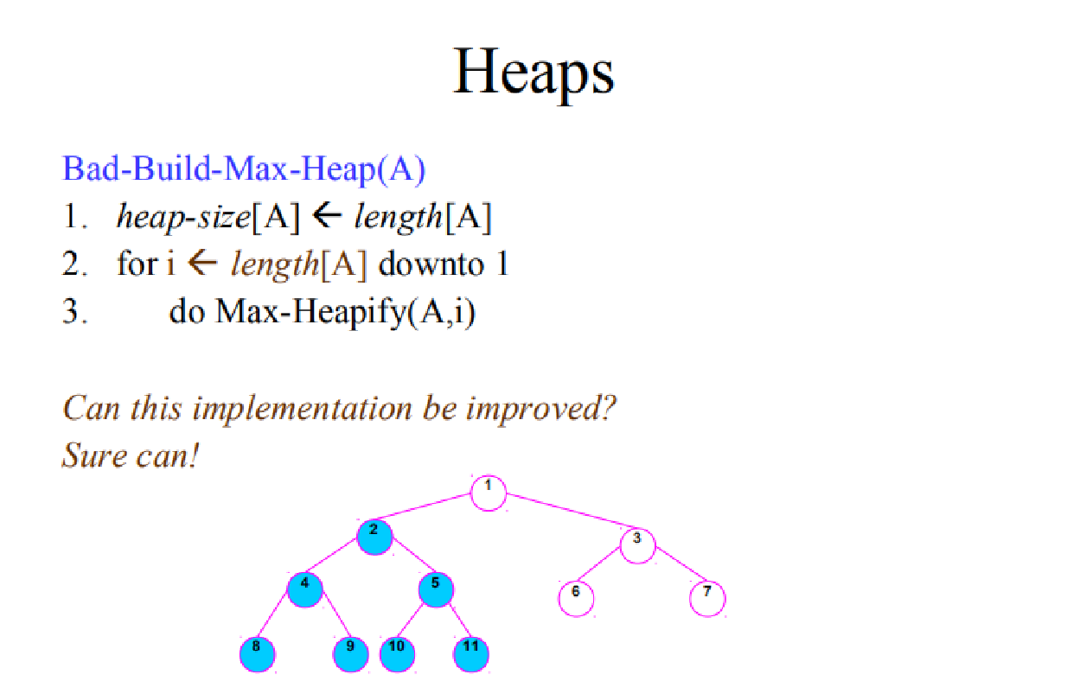

Slide 14
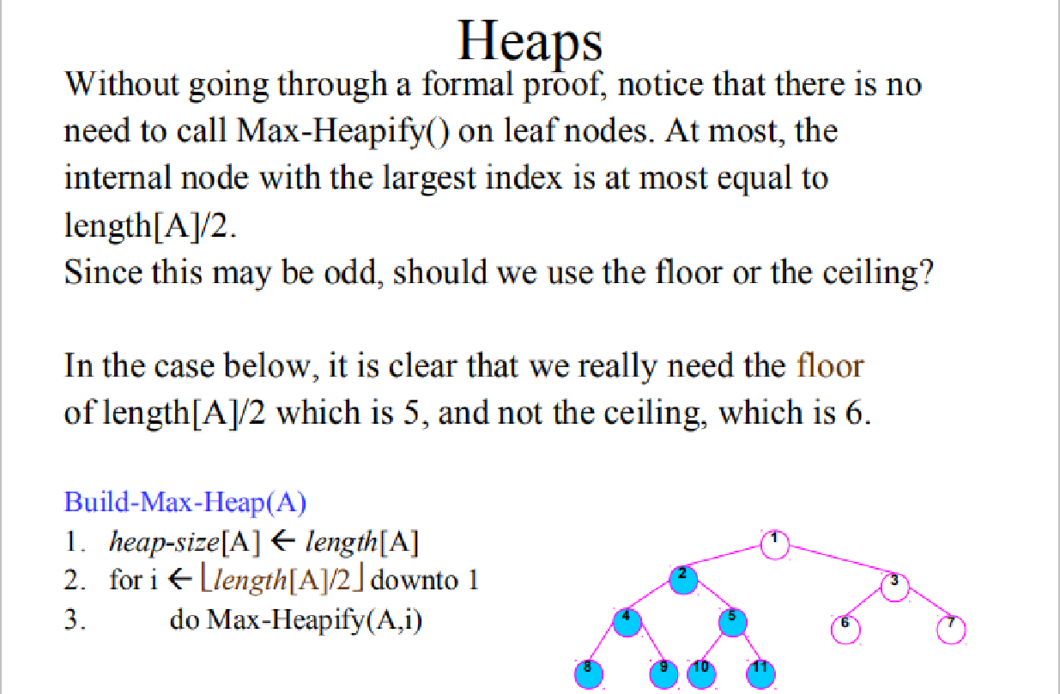

Slide 15
Example: building a heap (1)
1 2 3 4 5 6 7 8 9 10
4 1 3 2 16 9 10 14 8 7
1
4
2
1
3
3
4
2
5
16
6
9
7
10
8 9
14 8
10
7

Slide 16
Example: building a heap (2)
1
4
2
1
3
3
4
2
5
16
6
9
7
10
8
14
9
8
10
7

Slide 17
Example: building a heap (4)
1
4
2
1
3
3
4
14
5
16
6
9
7
10
8
2
9
8
10
7

Slide 18
Example: building a heap (5)
1
4
2
1
3
10
4
14
5
16
6
9
7
3
8
2
9
8
10
7

Slide 19
Example: building a heap (6)
1
4
2
16
3
10
4
14
5
7
6
9
7
3
8
2
9
8
10
1

Slide 20
Example: building a heap (7)
1
16
2
14
3
10
4
8
5
7
6
9
7
3
8 9
2 4
10
1

Slide 21
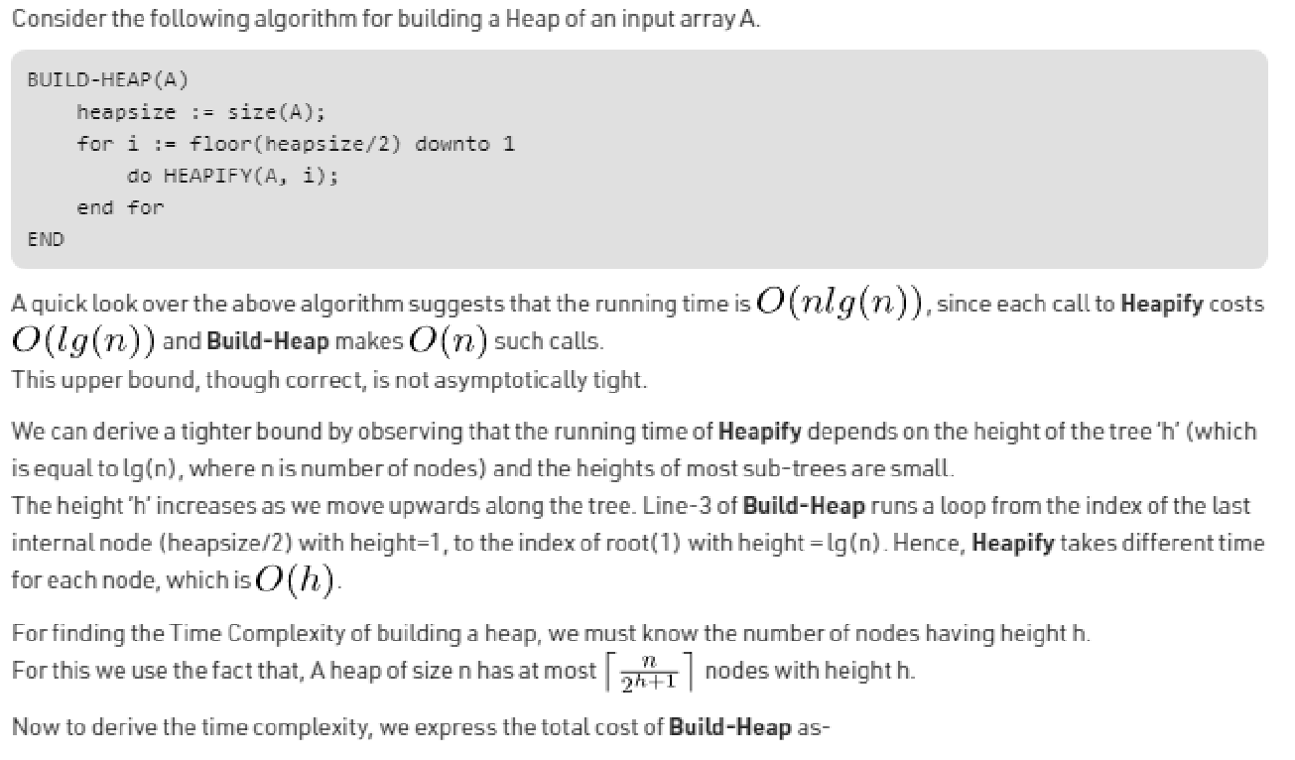
Build heap Time Complexity

Slide 22
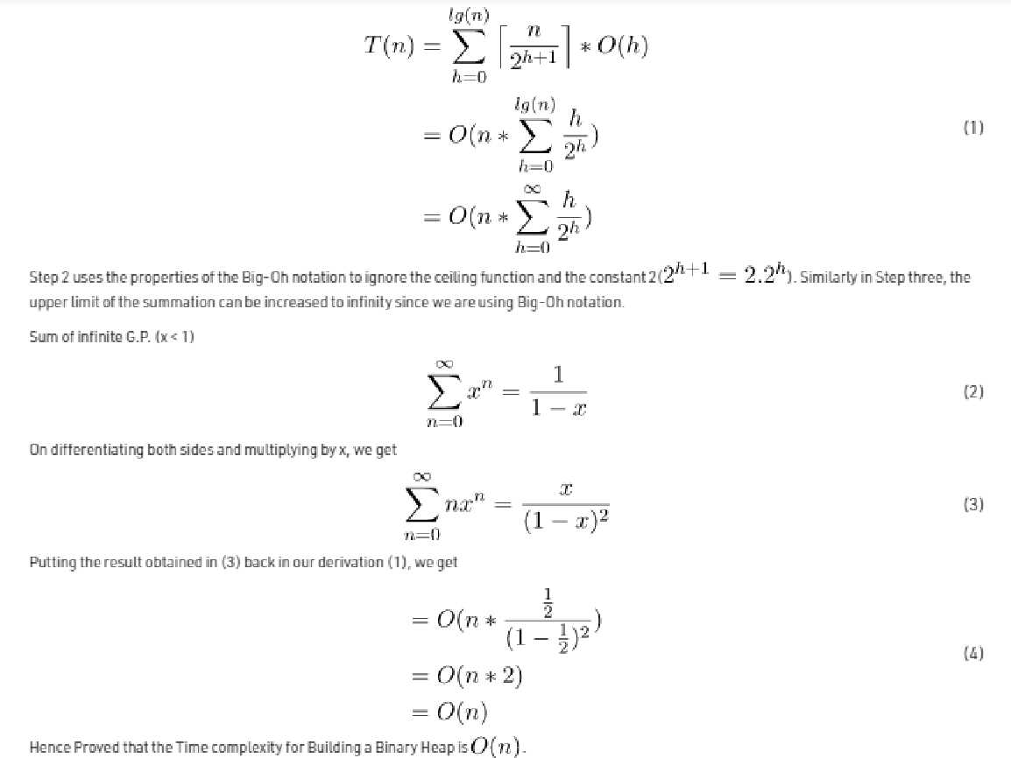

Slide 23
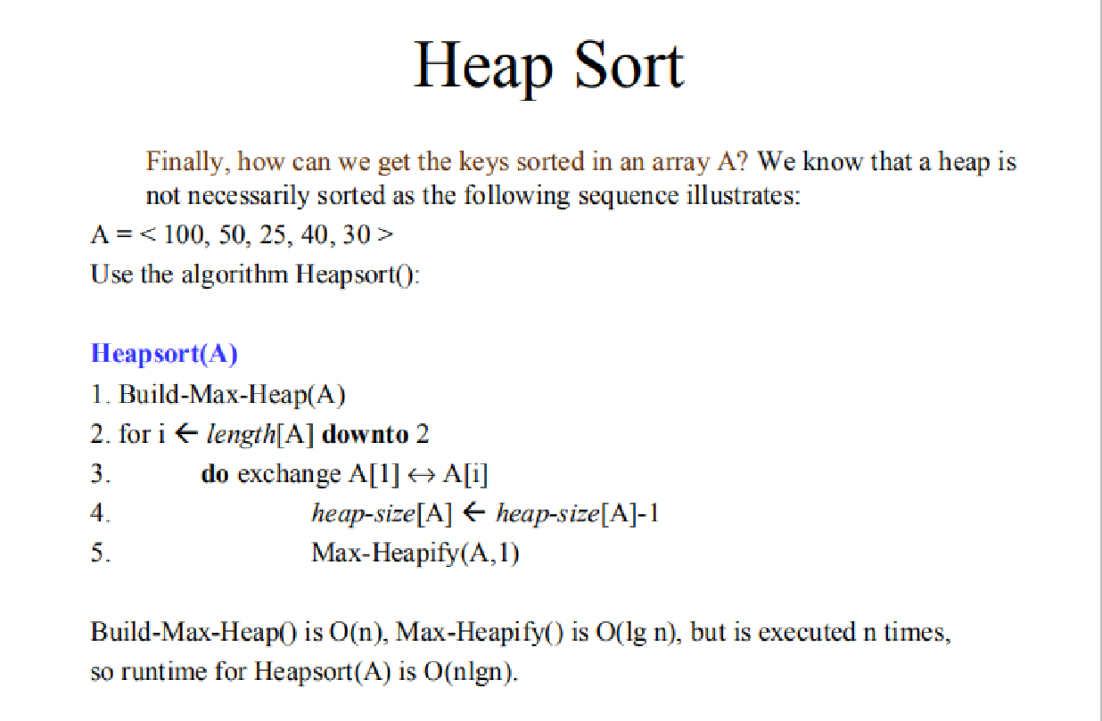

Slide 24
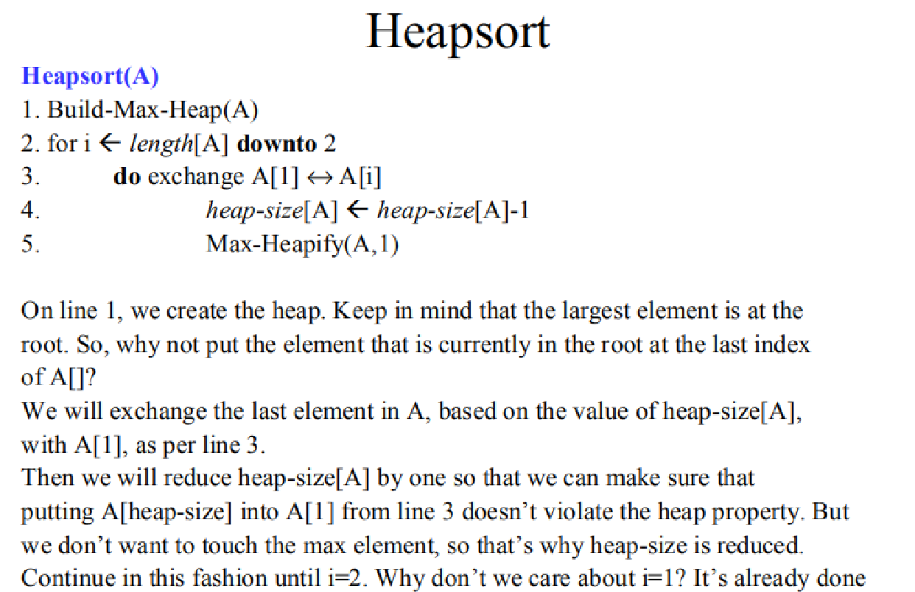

Slide 25
Example: Heap-Sort
1
16
3
10
2
14
4
8
5
7
6
9
7
3
8 9
2 4
10
1
16 14 10 8
7
9
3
2
4
1

Slide 26
Example: Heap-Sort (2)
1
14
2
8
3
10
4
4
5
7
6
9
7
3
8
2
9
1
10
16

Slide 27
Example: Heap-Sort (3)
1
10
2
8
3
9
4
4
5
7
6
1
7
3
8
2
9
14
10
16

Slide 28
Example: Heap-Sort (4)
1
9
2
8
3
3
4
4
5
7
6
1
7
2
8
10
9
14
10
16

Slide 29
Example: Heap-Sort (4)
1
8
2 3
7
3
4
4
5
2
6
1
7
9
8
10
9
14
10
16

Slide 30
Example: Heap-Sort (5)
1
7
2
4
3
3
4
1
5
2
6
8
7
9
8
10
9
14
10
16

Slide 31
Example: Heap-Sort (6)
1
4
2
2
3
3
4
1
5
7
6
8
7
9
8
10
9
14
10
16

Slide 32
Example: Heap-Sort (7)
1
3
2
2
3
1
4
4
5
7
6
8
7
9
8
10
9
14
10
16

Slide 33
Example: Heap-Sort (8)
1
2
2
1
3
3
4
4
5
7
6
8
7
9
8 9 ₁₀
10 14 16
1
2
3
4
7
8
9
10
14
16

